Slide 1
COAT STP5 – Field Study
Ryan Wood - GVSC
Rachel Anderson - GVSC
Andrew Hoelscher - GVSC
Jeffrey Schultz - GVSC
Victor Paul - GVSC
Alexander Reid - DCS
Steven Ratka - DCS
Kaitlyn Roose, PhD - DCS
Lauren Grant, PhD - DCS
Sumit Shrestha - DCS
DISTRIBUTION STATEMENT A.
Approved for public release; distribution is unlimited. OPSEC #10938

Slide 2
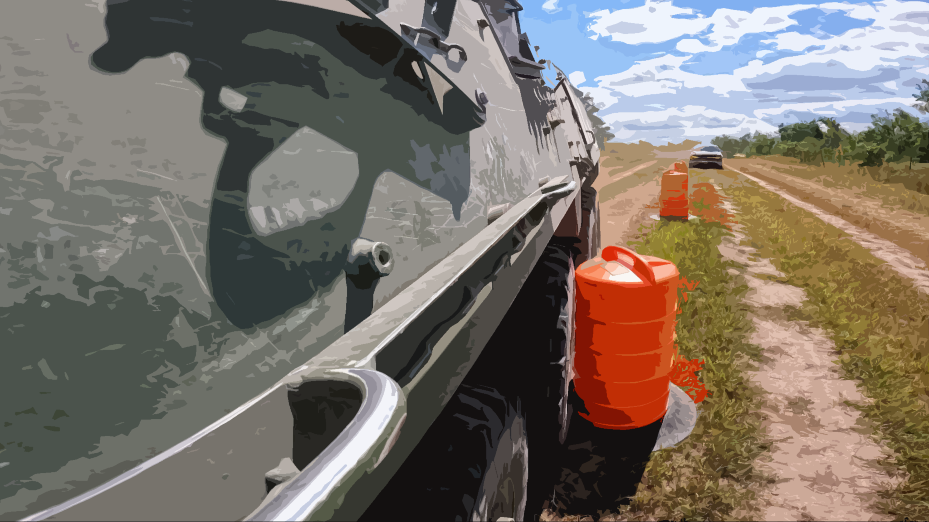
Contents
Overview
  Equipment
  Technology/Conditions
Route/Obstacles
Results

Slide 3
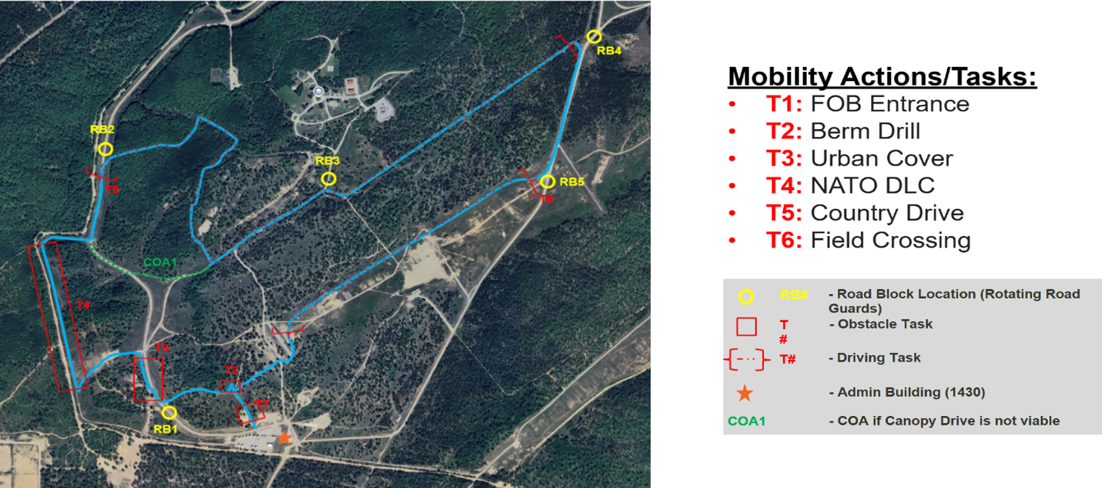
Overview
Soldier Touch Point seeking to compare driving performance between two UI systems
  Soldier Machine Interface on Vehicle Mounted Displays
  VitReal User Interface on Helmet Mounted Display
8 Soldiers were required to drive a Stryker vehicle through 6 obstacles in Grayling, MI.
      2 weeks; 4 Soldiers / wk
Completed 20 trials per week

Slide 4
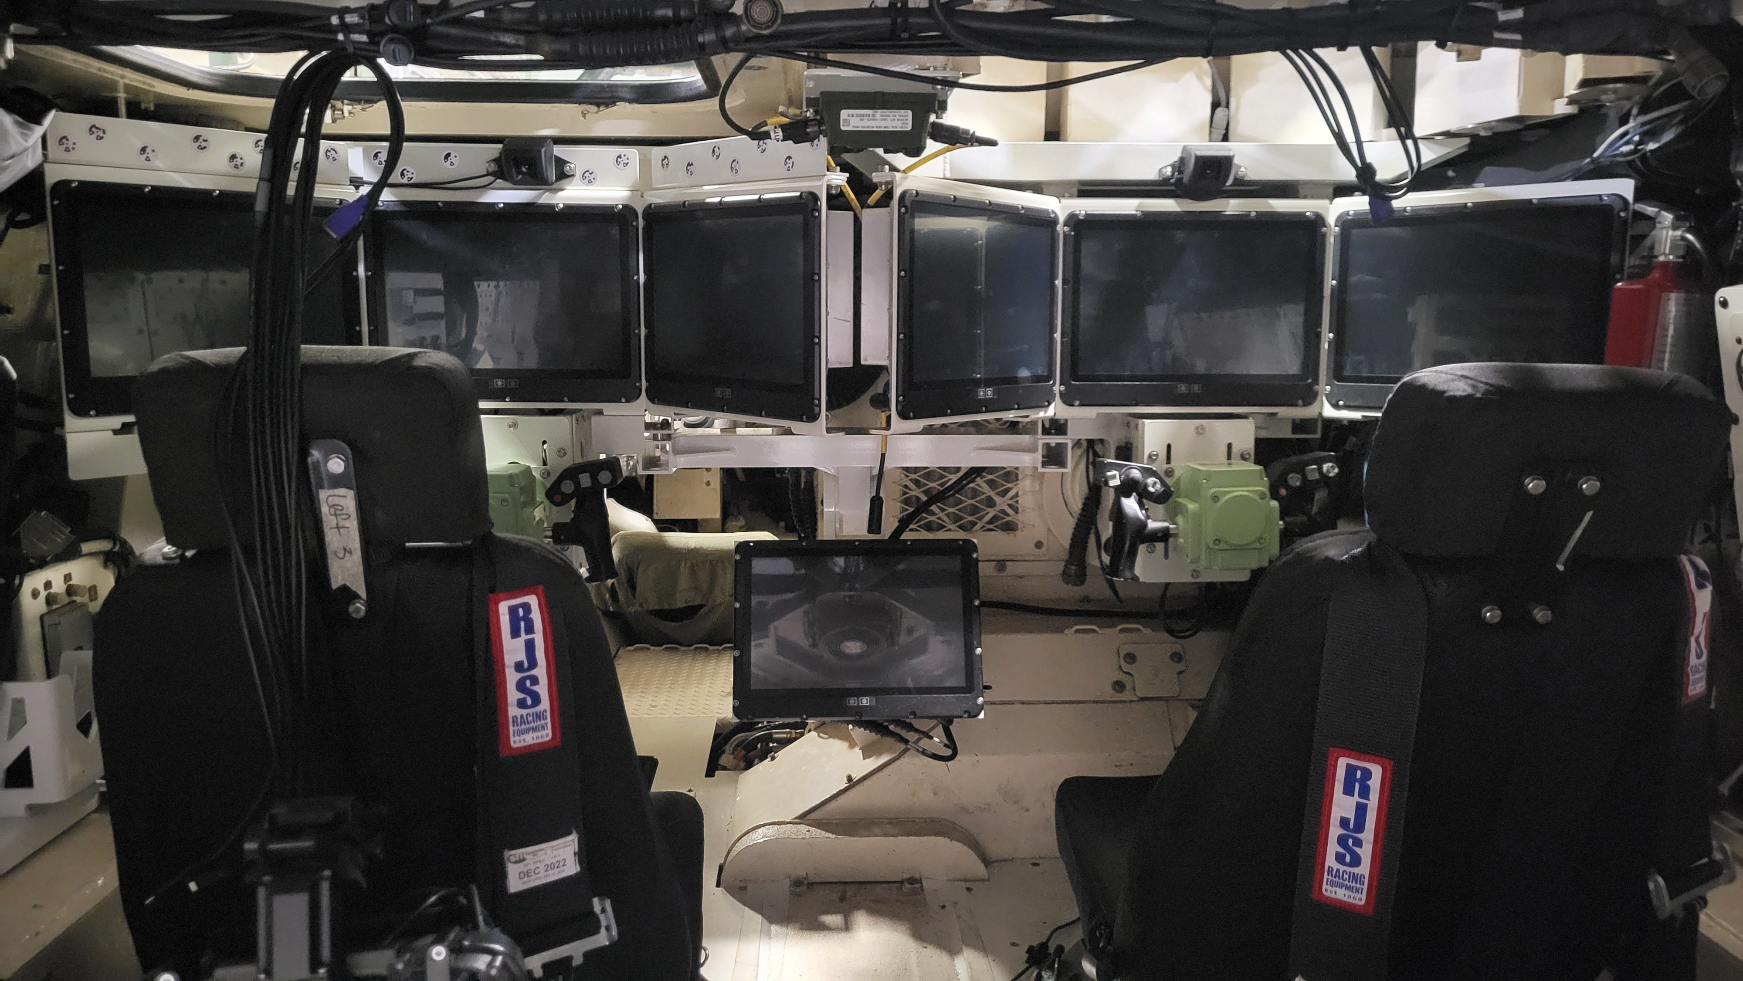
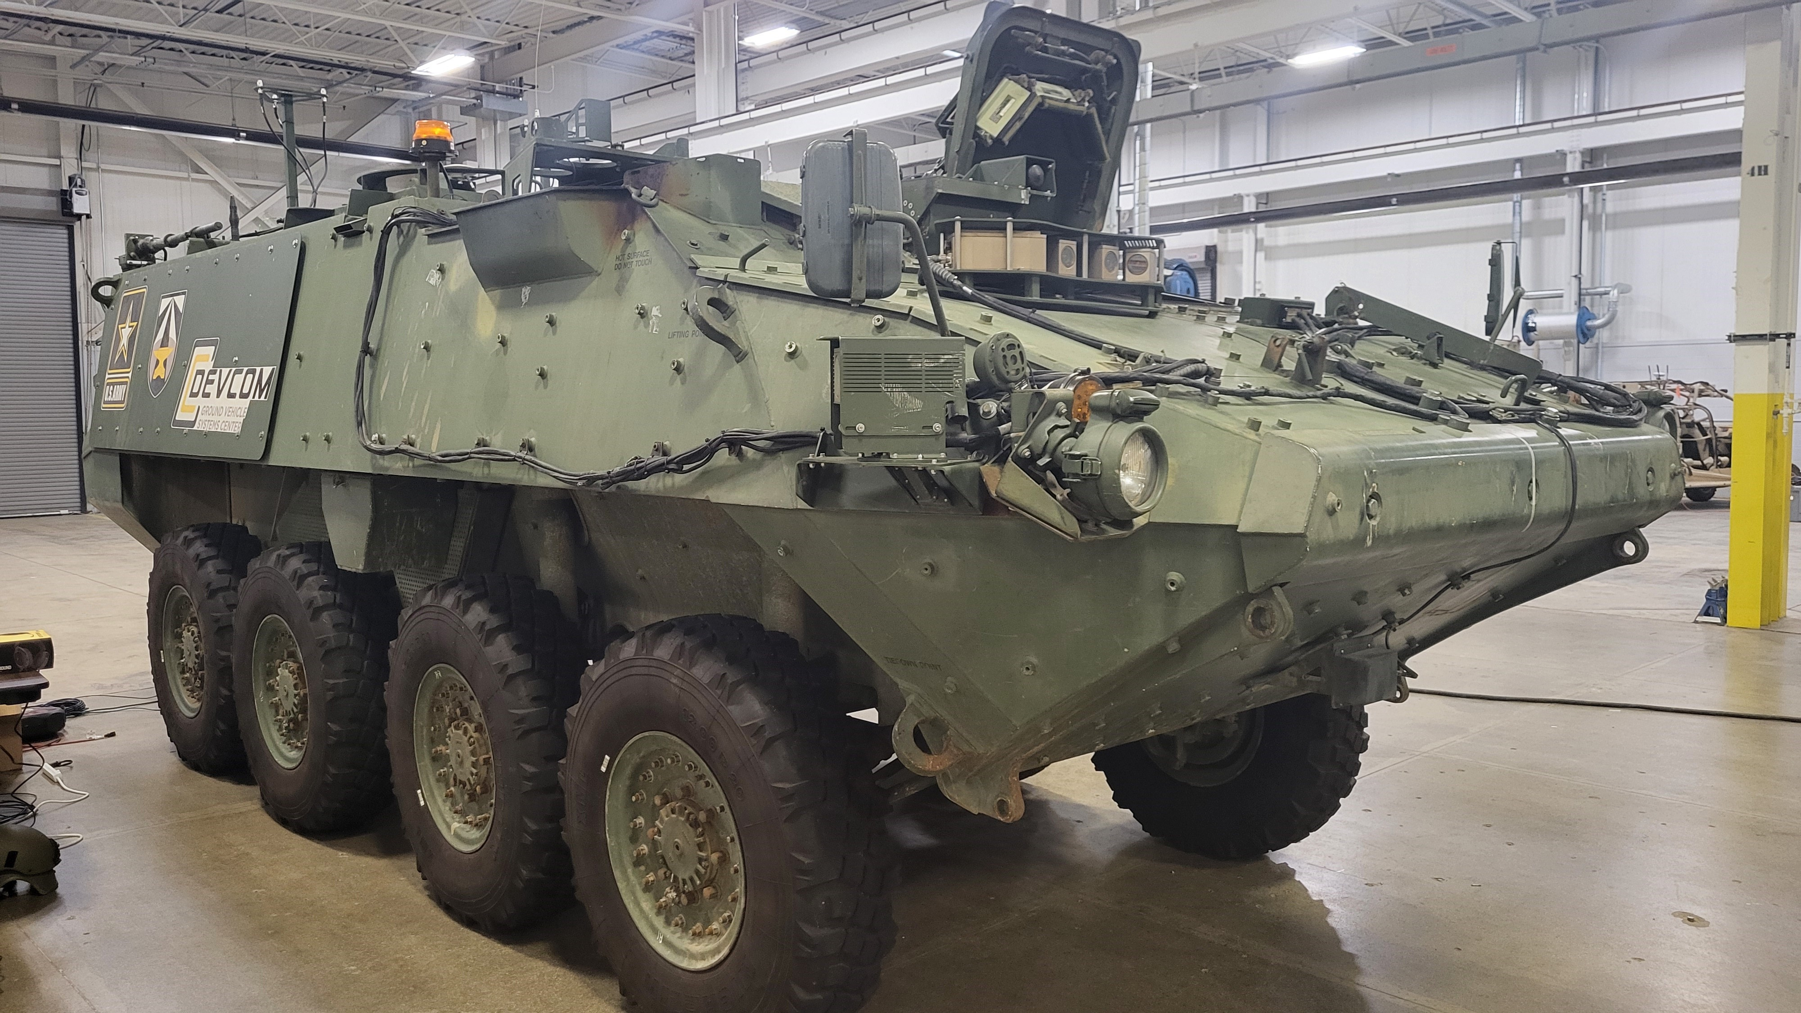
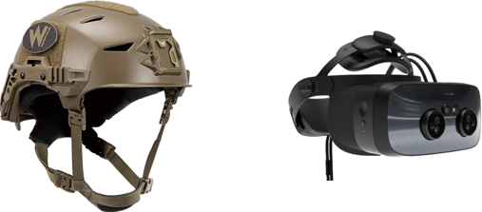
Equipment
Advanced Vehicle Crew Stations inside the COAT Stryker (right)
COAT Stryker Vehicle
  Helmet and Varjo HMD

Slide 5
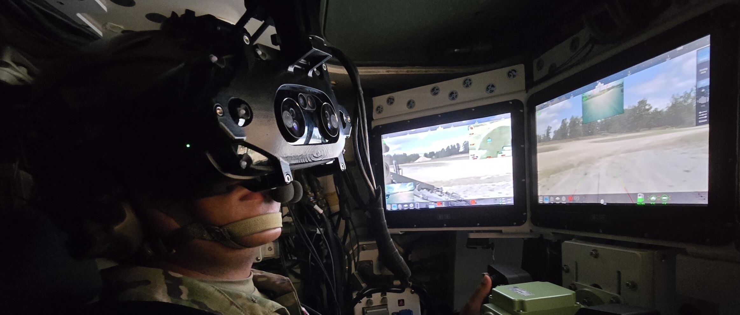
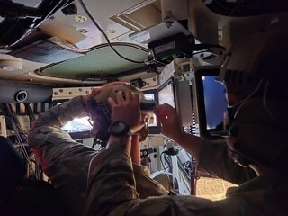
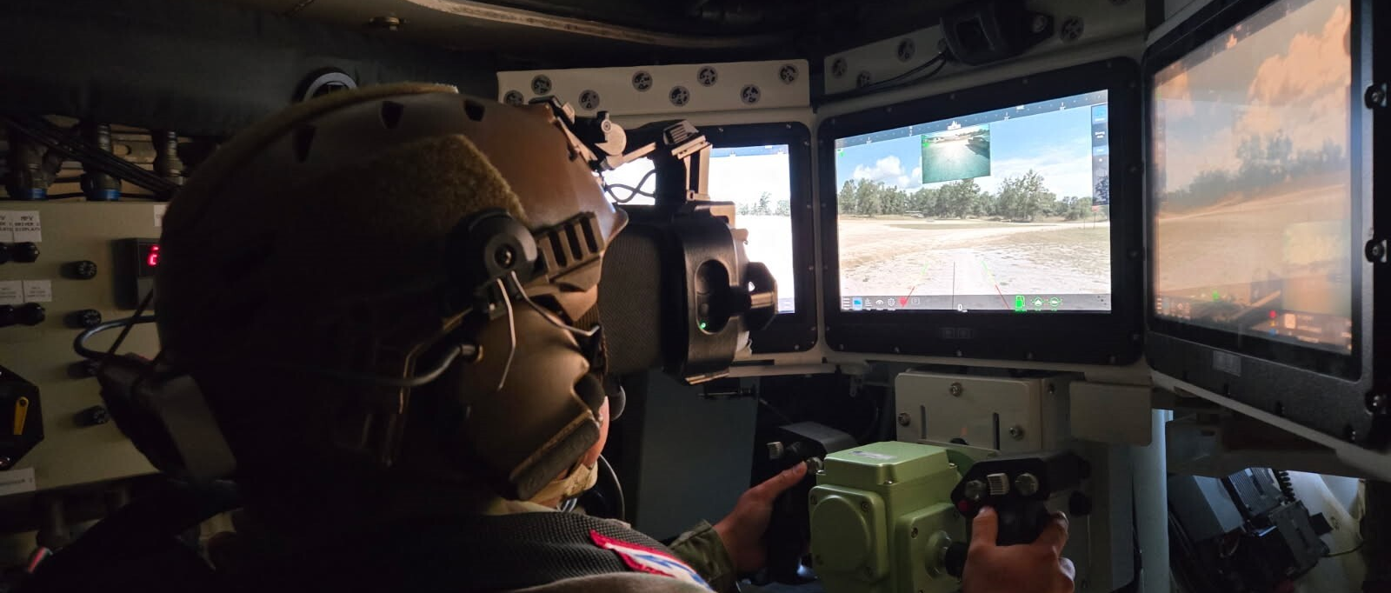
Soldier Pictures

Slide 6
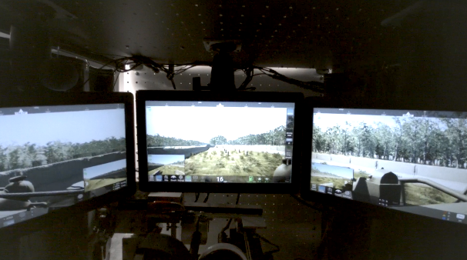
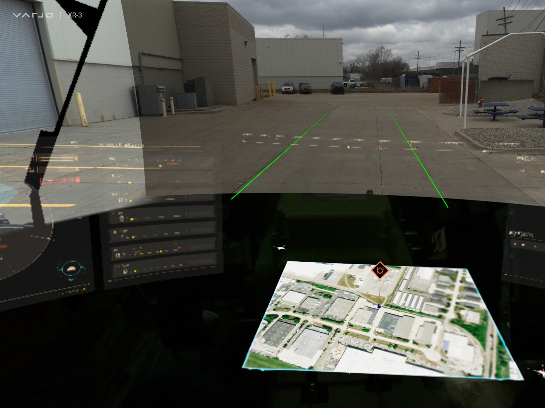
Technology
Advanced Vehicle Crew Stations inside the COAT Stryker (above)
Soldier Machine Interface (below)
Soldier Helmet (above left); Varjo HMD (above right)
VitReal User Interface (below)

Slide 7
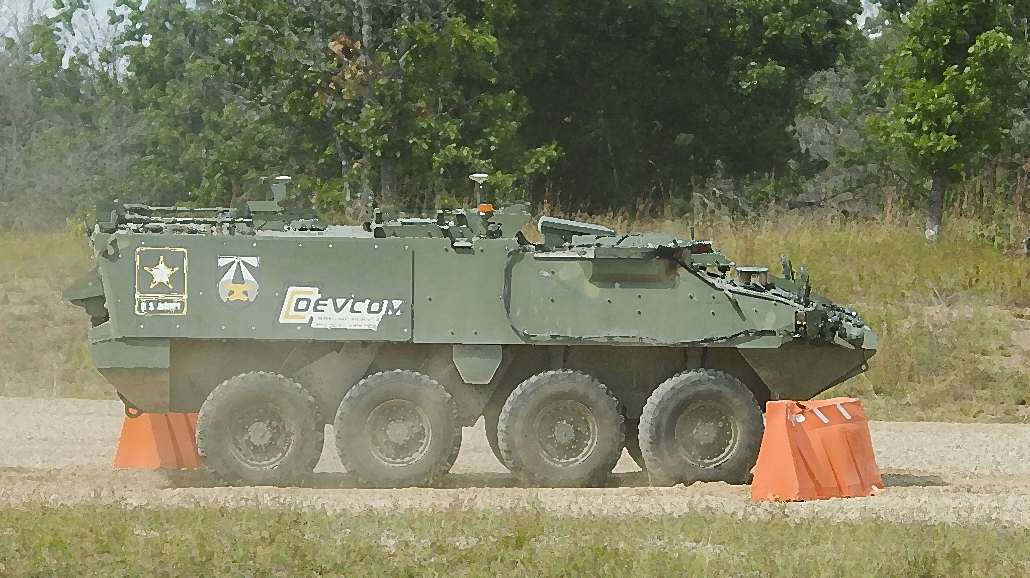
Obstacles

Slide 8
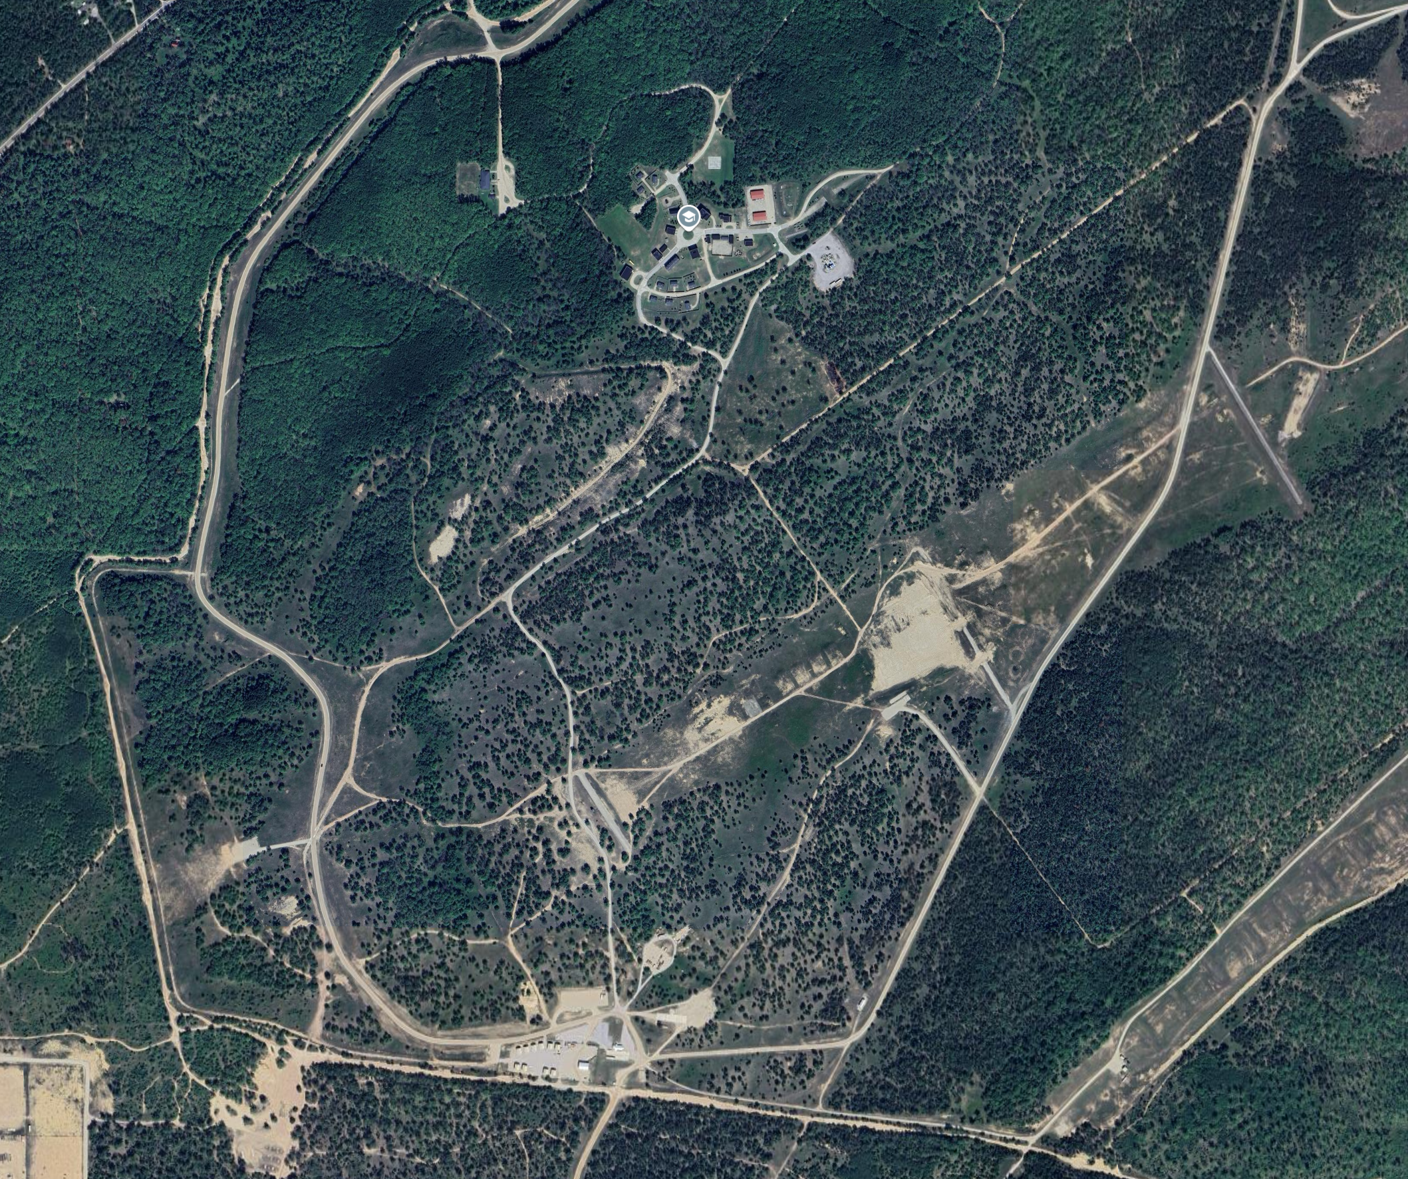
STP5 ROUTE AND OBSTACLE LOCATIONS
RB4
RB2
T5
RB5
T6
COA1
T4
T3
T2
T1
RB1

Slide 9
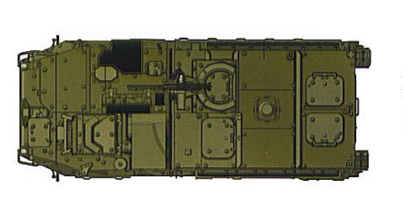
Fob Entrance animation

Slide 10
Berm Drill animation
1
2

Slide 11
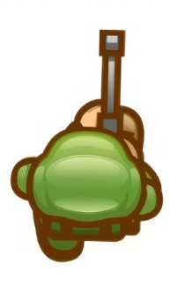
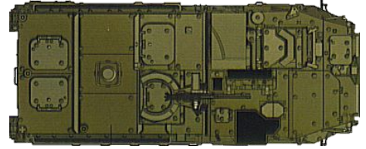
Urban cover animation
Stop, peak. Move, stop, peak.
Data to collect
  Time to complete
  Stopping position: Short/Aligned/Far

Slide 12
Double lane change movement
NATO AVTP – Double Lane Change
Data to collect
  Time to complete
  Barrels hit

Slide 13
Country Drive Location
Data to collect:
Time to completion

Slide 14
Field crossing Location
Data to collect:
Time to completion
`

Slide 15
Questionnaires
Pre Screening
  Motion Sickness Screening Questionnaire
  Demographics
Post Trial Questionnaires
  Modified NASA TLX (overall subjective workload)
  Situation Awareness (overall subjective SA)
  Simulator Sickness (motion sickness monitoring)
Post Week Questionnaire
  User Interface Usability Questionnaire
  After Action Review

Slide 16
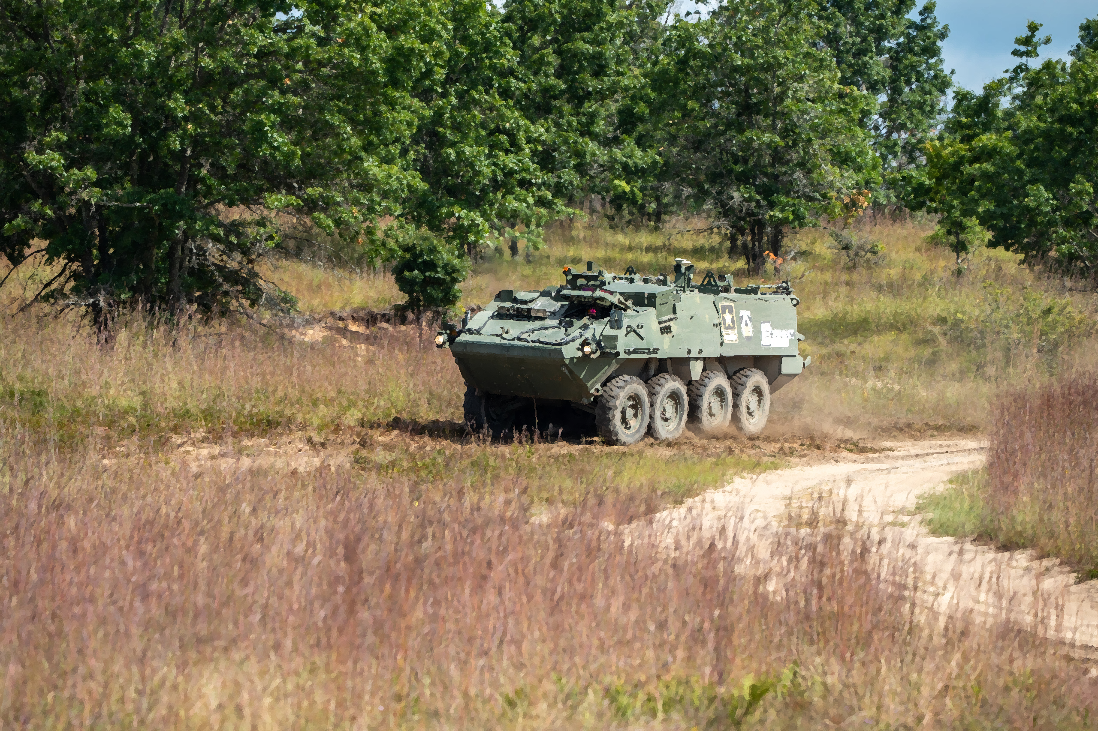
Results

Slide 17
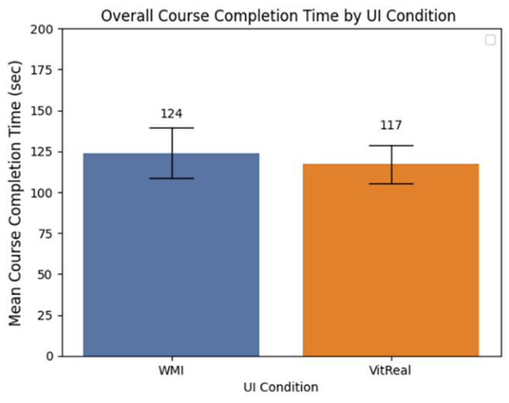
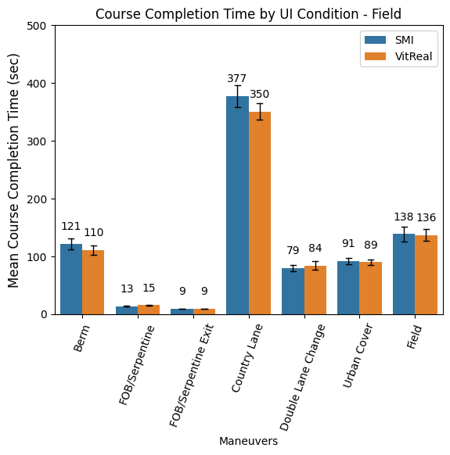
Course Completion Time
No significant difference was found between the course completion time across the two UI conditions.
Soldiers were able to drive the vehicle at course speed (up to 35mph) while utilizing either the HMD and VMD.

Slide 18
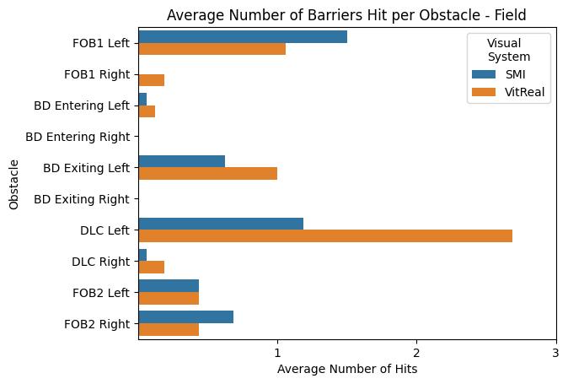
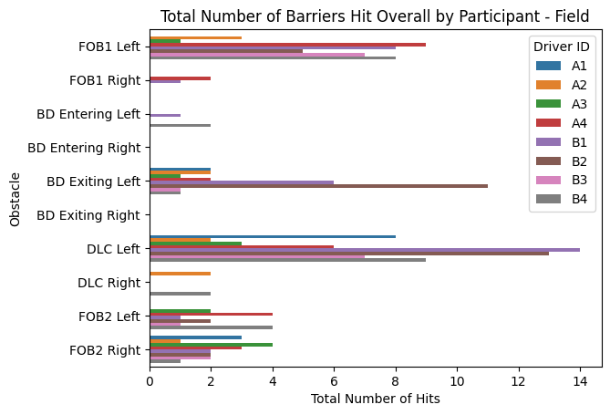
Obstacles Hit
Overall, Soldiers hit more obstacles on the left side of the vehicle compared to the right.
We assert that this finding is due to the front camera position being located right of center.

Slide 19
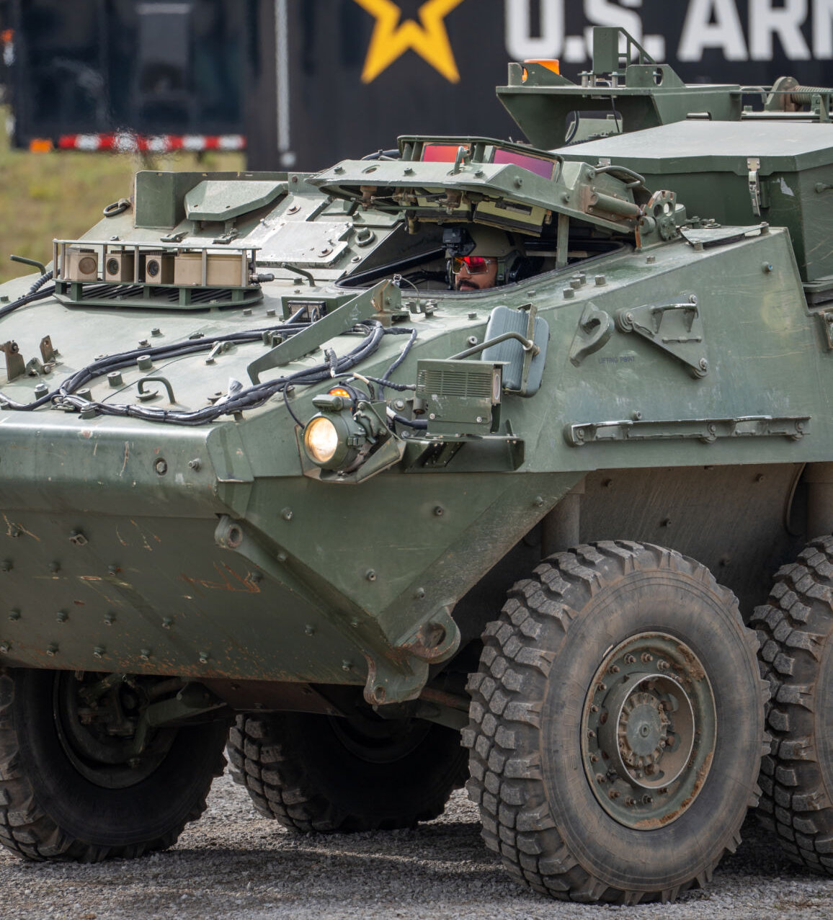
Front Camera Position in relation to Safety Driver

Slide 20
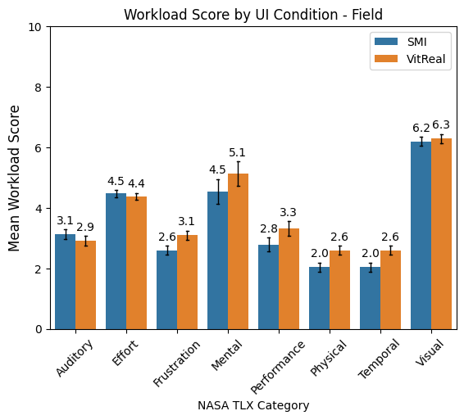
Results
HMD scored higher in subjective workload in the following areas:
Frustration
Physical
Temporal

Slide 21
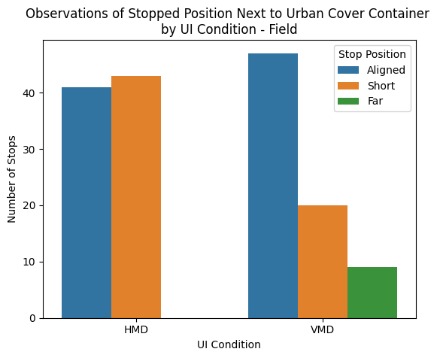
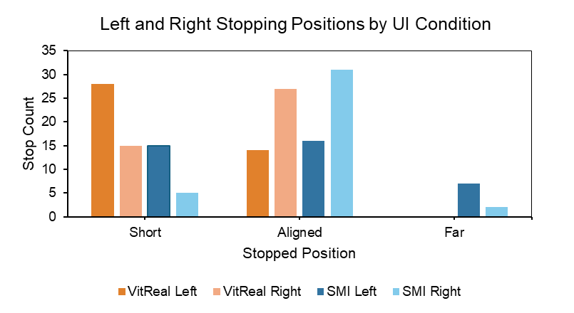
Results
Stopping position during the urban cover maneuver showed that Soldiers stopped short of the containers more frequently when using the HMD.
Additionally, Soldiers only stopped far of the container when using the VMD.
We assert that these differences are due to the location of the UI in relation to the user.

Slide 22
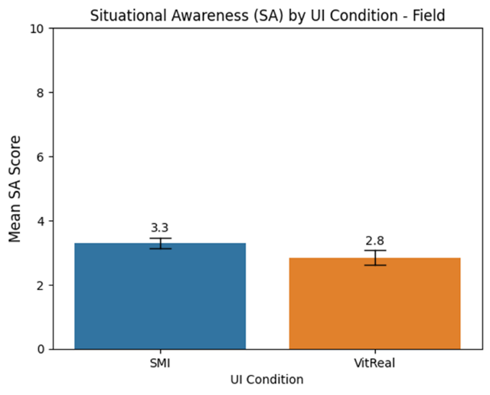
Results
Soldiers rated VitReal as providing slightly higher SA (lower score) in comparison to the VMD, but not a significant difference.

Slide 23
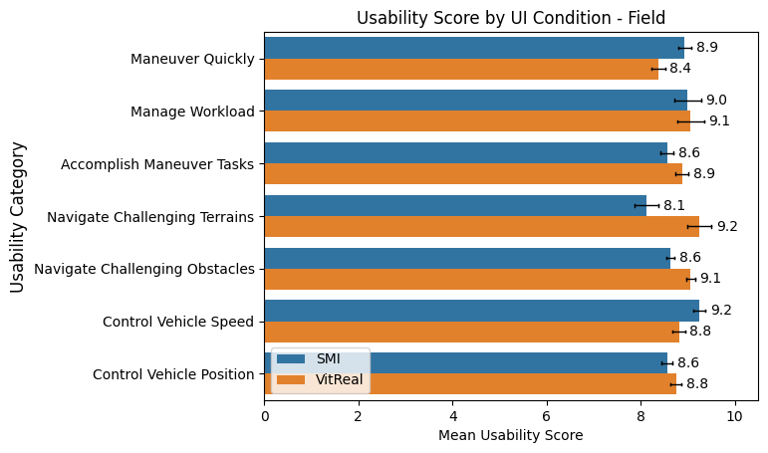
Results
The Usability Questionnaire indicated that differences in the following areas:
Higher usability ratings for Maneuvering Faster and Controlling Speed with the VMD
Higher usability ratings for Navigating Challenging Terrains with the HMD
AARs indicated that Soldiers preferred using the HMD for more complex tasks that required scanning/detection and the VMD for general mobility tasks.

Slide 24
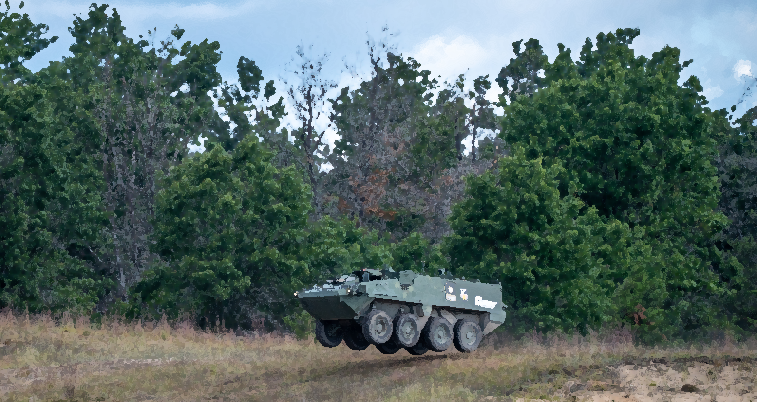
Thank You

